Slide 1
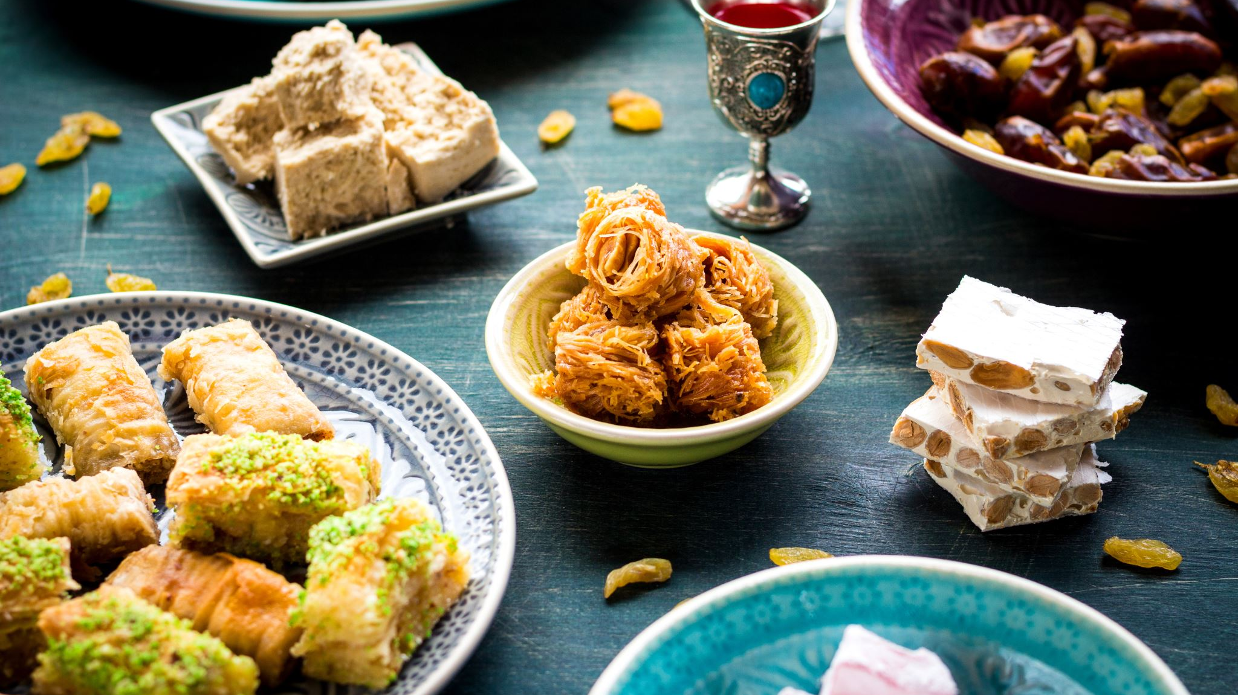
God’s Roadmap of Redemption
The Feasts of the Lord
Leviticus 23

Slide 2
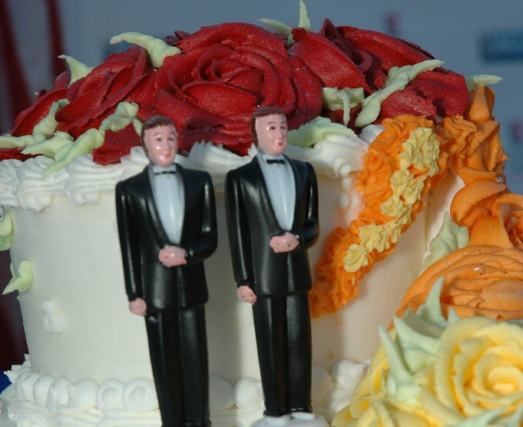
Society is crumbling
Poverty – refugees
Gap between rich and poor
Social norms
Marriage
Gender

Slide 3
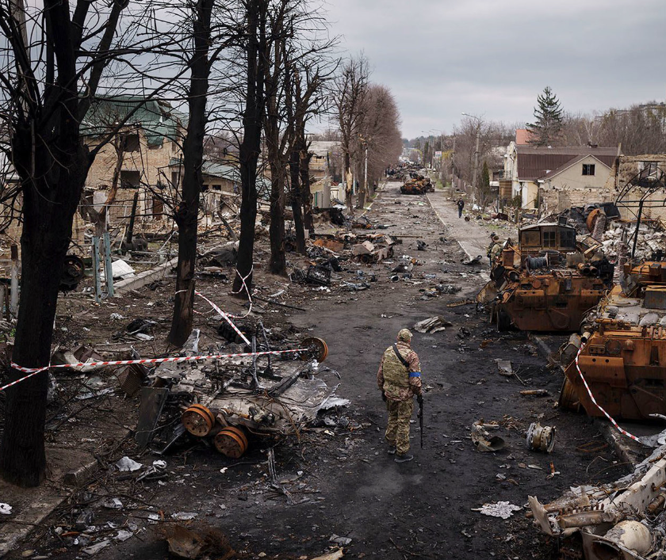
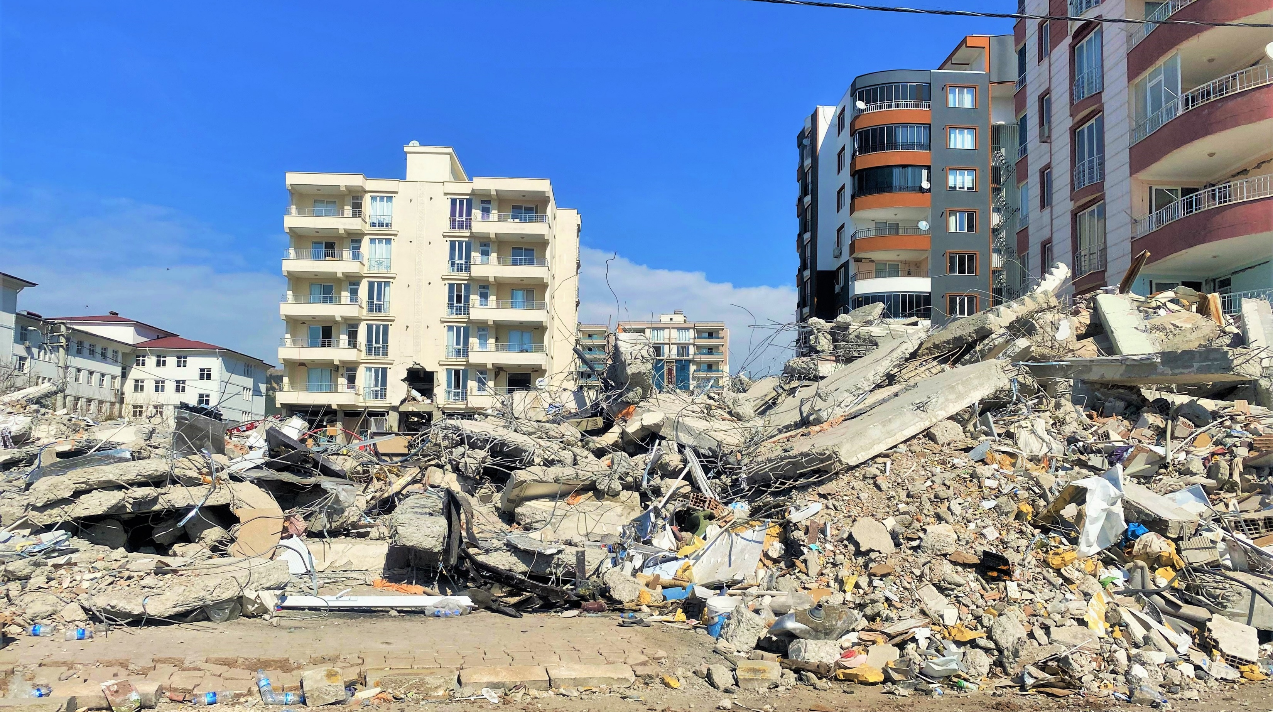
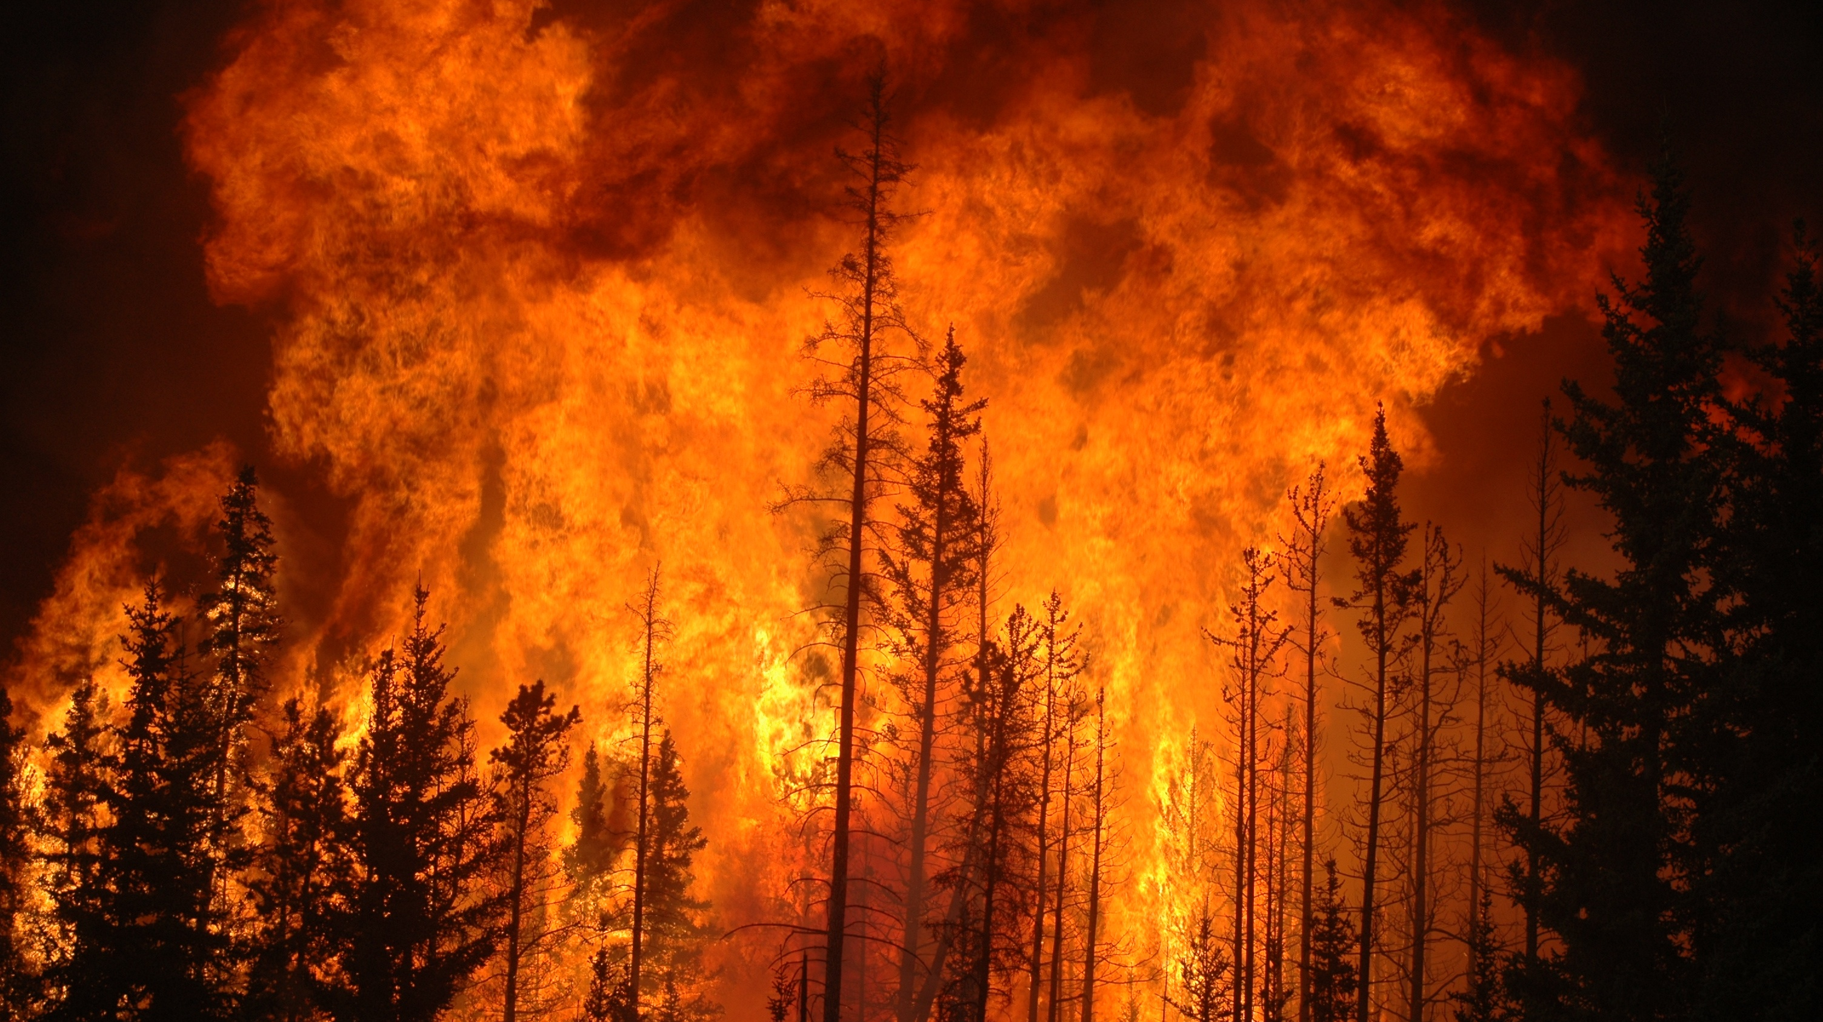
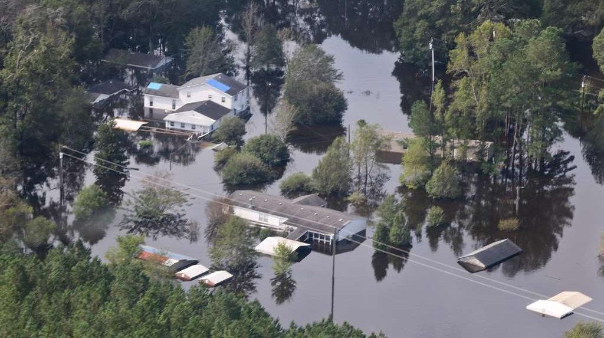
War Earthquakes Fire Floods

Slide 4
Technology
Hedonism (influencers)
Fake News
AI

Slide 5
God is in control
Amidst the whirlwind of the modern world, where chaos often seems to hold sway, a constant truth remains: God's unwavering control extends beyond what meets the eye. Leviticus 23 sheds light on this through the Feasts of the Lord. These sacred observances not only hold historical and cultural significance but also serve as a roadmap pointing towards a greater redemptive plan for humanity. It's in these Feasts that we find foreshadowing of the coming Messiah, Jesus, and His future return. In exploring the Feasts of the Lord, we catch a glimpse of how God's enduring guidance is intricately woven into the fabric of time, revealing His ultimate purpose for all.
ChatGPT

Slide 6
The Feasts of the Lord
Leviticus 23
God’s plan of redemption revealed
These prophetic feasts were / will be fulfilled in the Messiah – Jesus
Provide hope that God is in control

Slide 7
The Feasts of the Lord
¹The LORD spoke to Moses, saying, ²“Speak to the people of Israel and say to them, These are the appointed feasts of the LORD that you shall proclaim as holy convocations; they are my appointed feasts. “ Leviticus 23 (ESV)

Slide 8
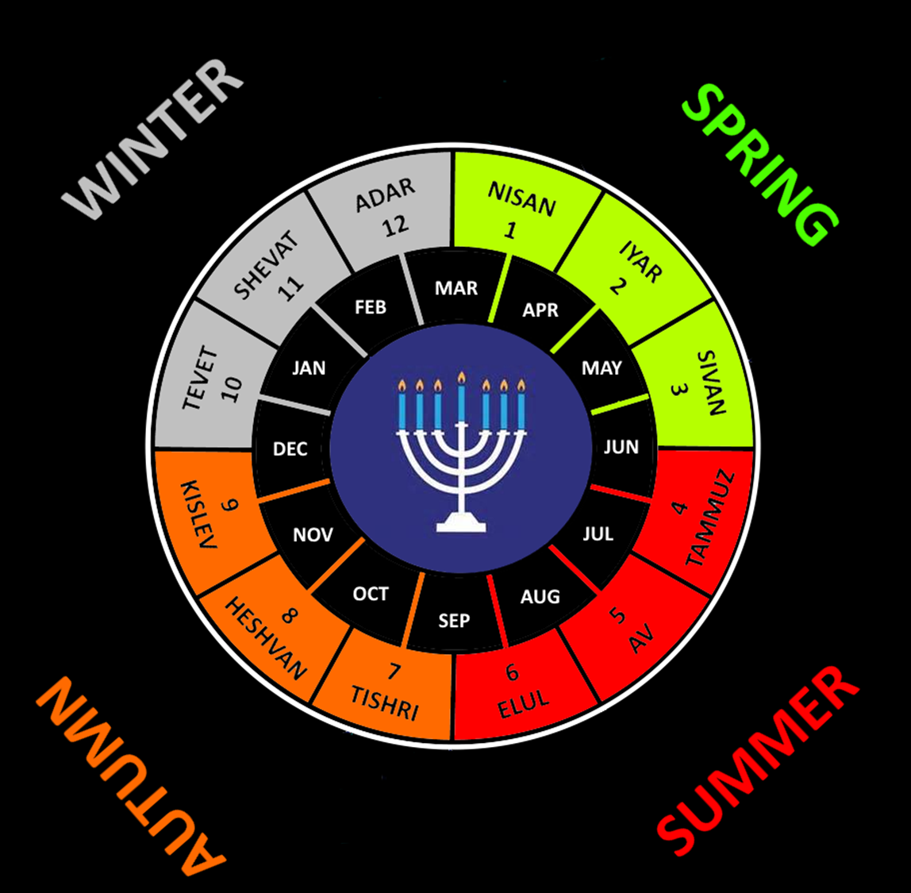

Slide 9
Genesis 1:14
¹⁴And God said, “Let there be lights in the expanse of the heavens to separate the day from the night. And let them be for signs and for seasons [or appointed times or feasts], and for days and years, ¹⁵and let them be lights in the expanse of the heavens to give light upon the earth.” And it was so.

Slide 10
The Feasts of the Lord
Feast | Hebrew Name | Pronunciation | Scripture
Sabbath | Shabbat | Shah-BAHT | Leviticus 23:3
Passover | Pesach | PAY-sakh | Leviticus 23:5
Feast of Unleavened Bread | Chag HaMatzot | Chahg Hah-MAT-zote | Leviticus 23:6
Firstfruits | Yom HaBikkurim | YOHM Hah-Bih-KUR-ihm | Leviticus 23:9-14
Feast of Weeks or Pentecost | Shavuot | SHAR-voo-ote | Leviticus 23:15-21
Feast of Trumpets | Yom Teruah or Rosh Hashanah | YOHM Tore-oo-ah ROSHE-Hah-SHAH-nah | Leviticus 23:23-25
Day of Atonement | Yom Kippur | YOHM kip-PURR | Leviticus 23:26-32
Feast of Booths or Tabernacles or Tents | Sukkot | Soo-KOTE | Leviticus 23:33-43

Slide 11
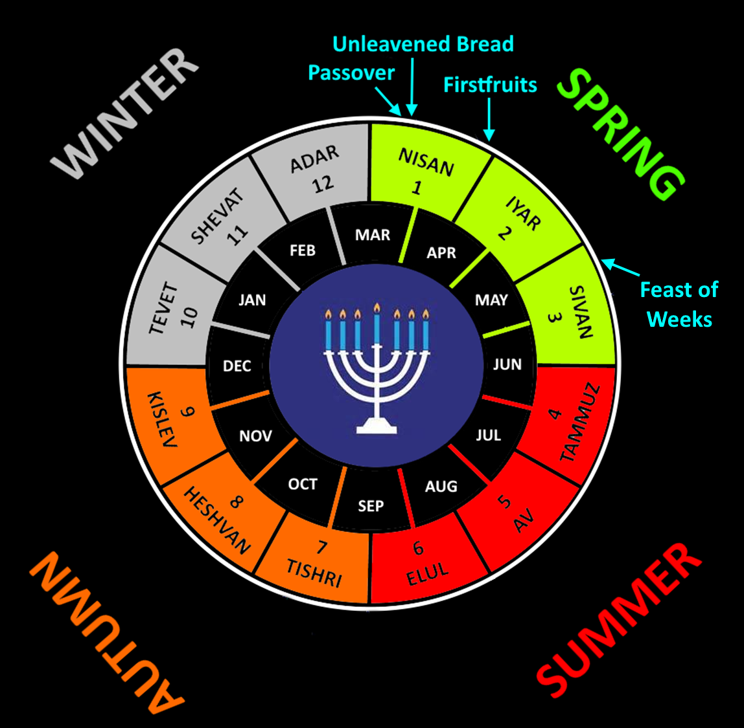

Slide 12
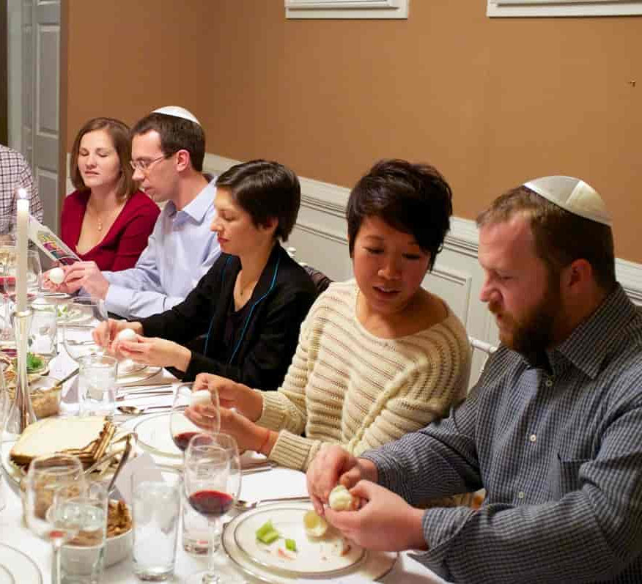
Passover Leviticus 23:5
Jesus was crucified at the same time as the Paschal Lambs were being sacrificed.
1 Corinthians 5:7
1 Peter 1:18-20
Hebrews 4:15
Romans 8:2

Slide 13
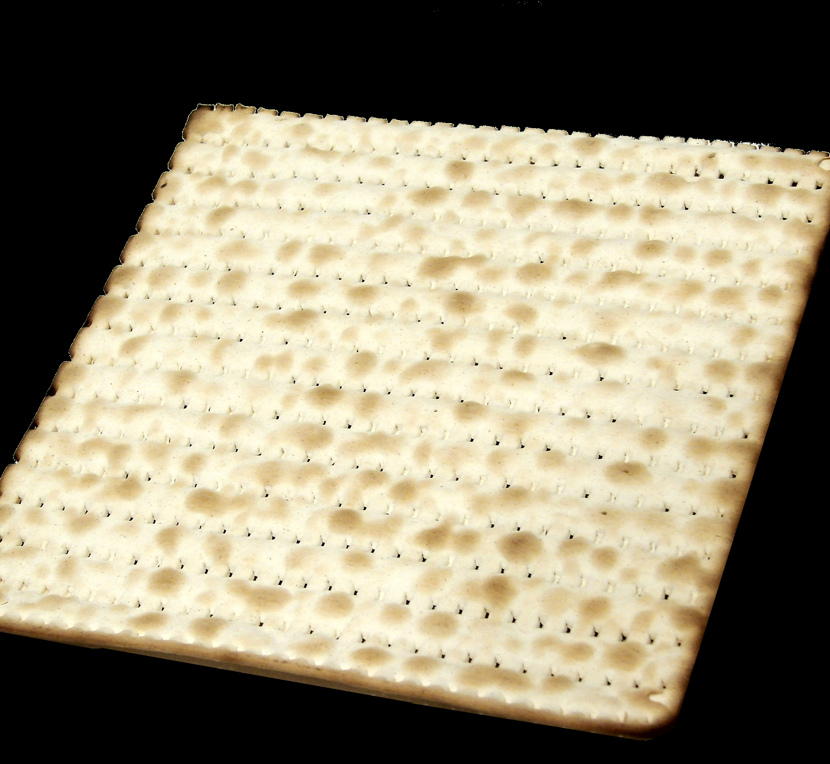
Feast of Unleavened Bread Leviticus 23:6
Matzah is:
Striped – Isaiah 53:5
Pierced – Zechariah 12:10
Broken – Luke 22:19
The Bread of Affliction – Isaiah 53:4

Slide 14
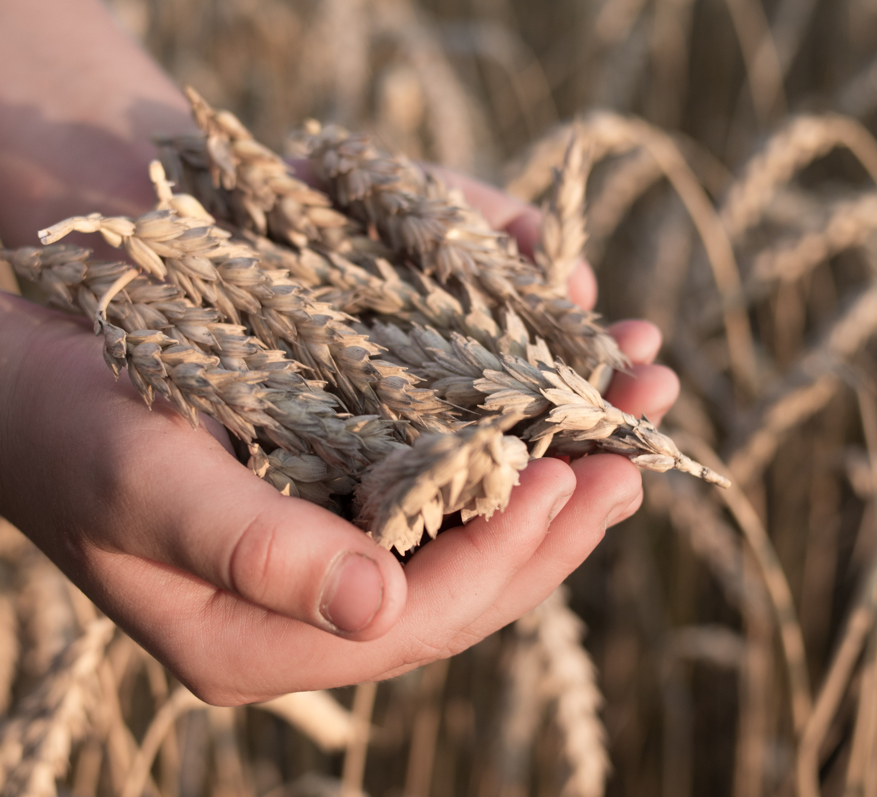
Firstfruits Leviticus 23:9-14
Jesus rose on the Feast of Firstfruits
Celebration of the harvest to come
1 Corinthians 15:20

Slide 15
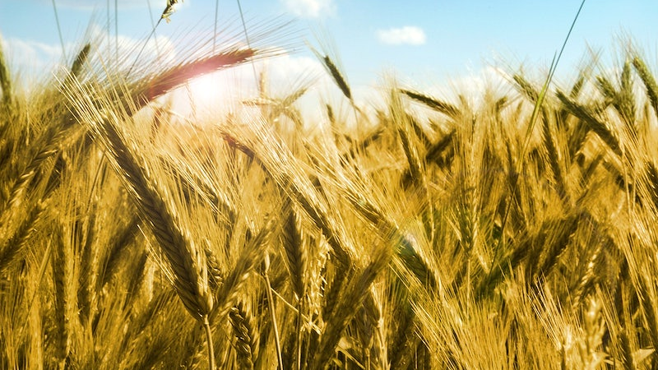
Feast of Weeks Leviticus 23:15-21
Greek - Pentecost
Celebration of the full harvest and the giving of the Law
At Mt Sinai 3,000 died Exodus 32:25-28
At Pentecost 3,000 saved Acts 2:40-41

Slide 16
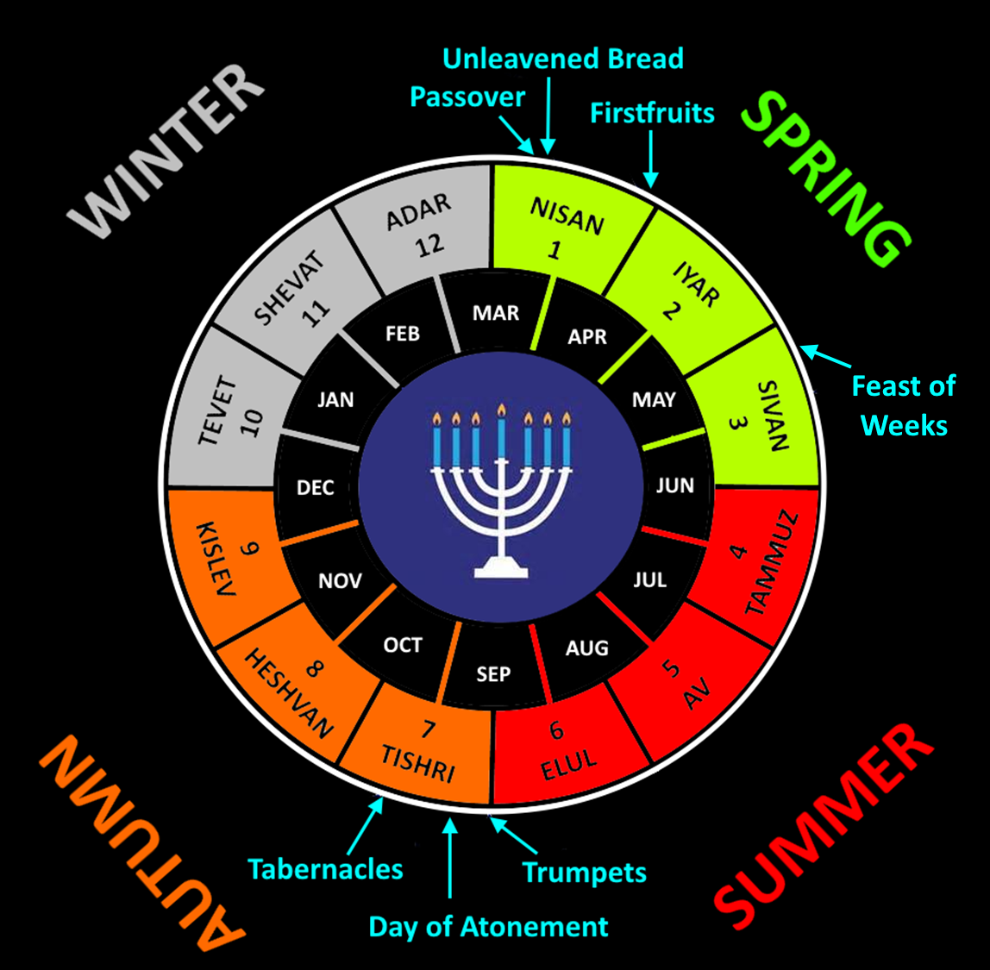

Slide 17
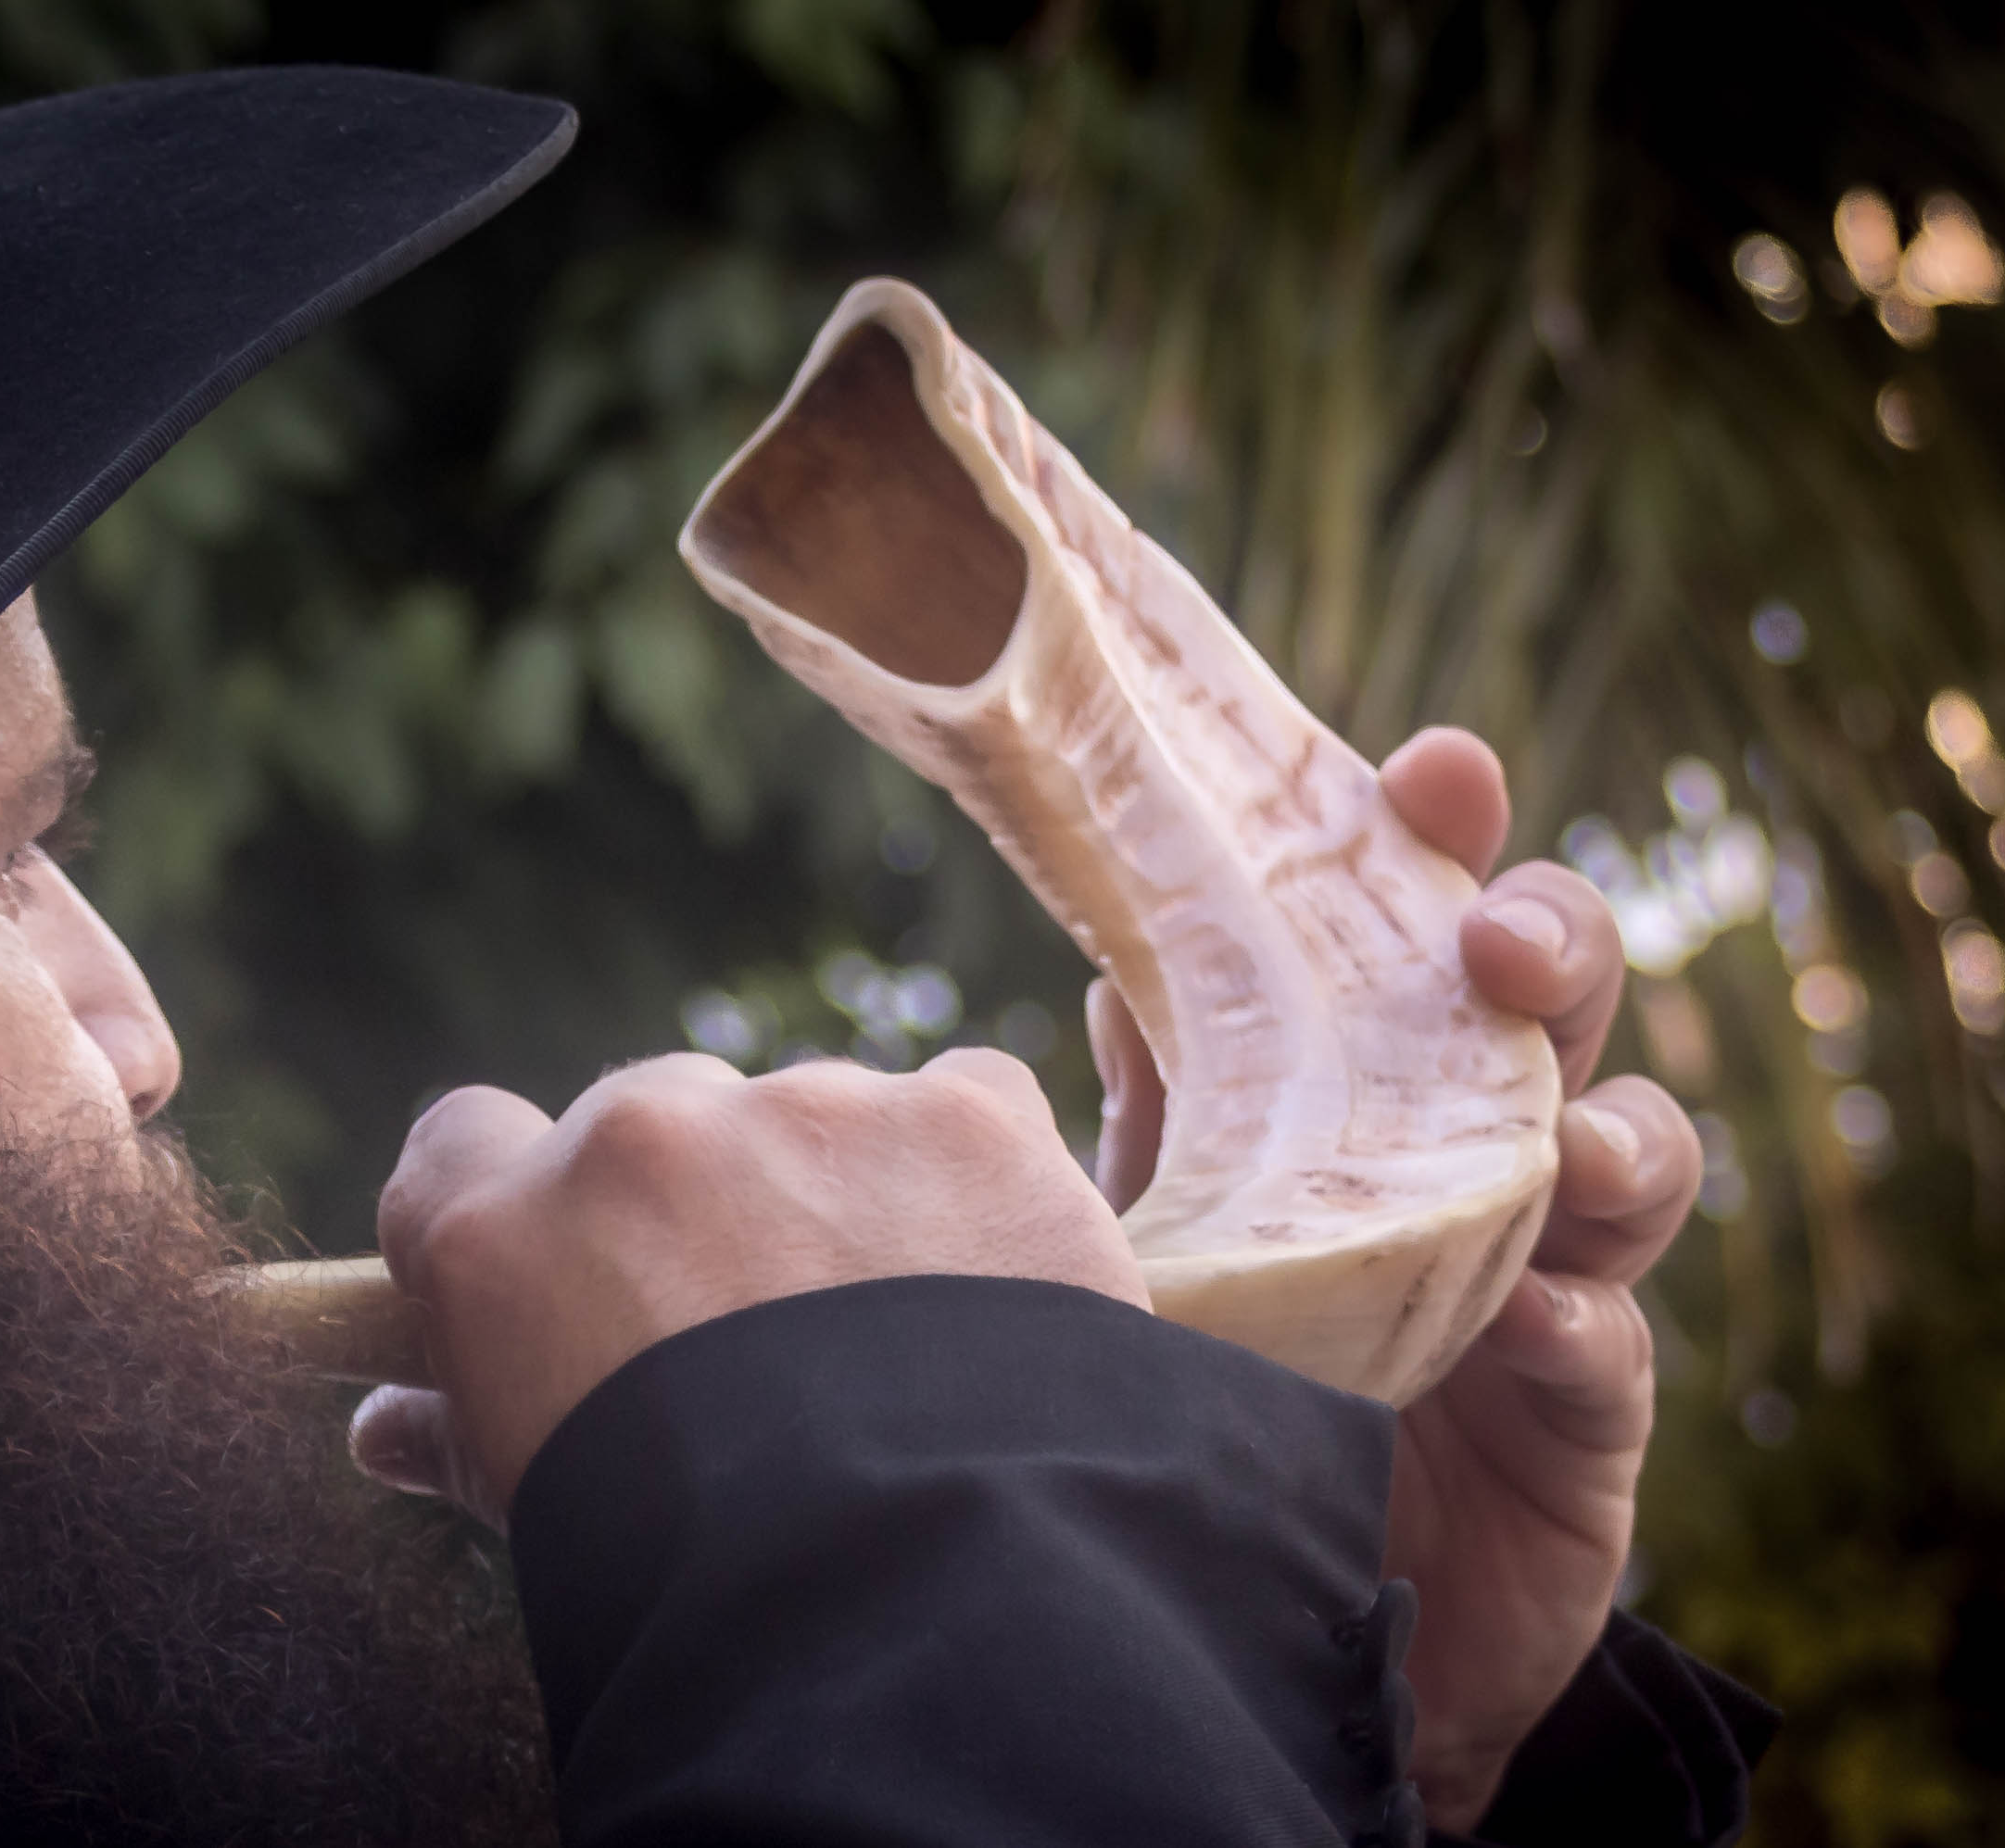
Feast of Trumpets Leviticus 23:23-25
Rosh Hashanah – Jewish New Year
Begins 10 Days of Awe
Seek to have their name in the Book of Life
Shofur sounded to usher in the new era
1 Thessalonians 4:13-18
1 Corinthians 15:52

Slide 18
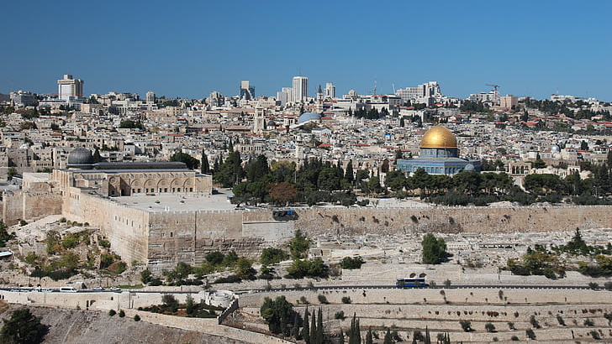
Day of Atonement Leviticus 23:26-32
Points to the Second Coming of Christ
Jewish remnant will:
Look upon Him whom they have pierced Repent of their sins Receive Him as Messiah Zechariah 12:10 13:1 14:9

Slide 19
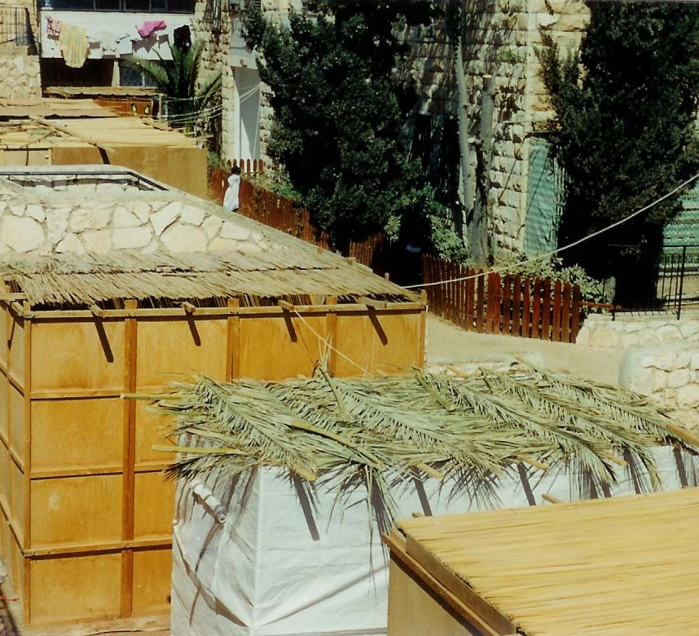
Feast of Booths or Tabernacles or Tents Leviticus 23:33-43
God will dwell (tabernacle) with His people
Micah 4:1-7

Slide 21
Hope for us . . .
God has had a plan for the world since the beginning
It can be seen in the Feasts of the Lord
He told us of the chaos in Matthew 24:6-7
No matter how chaotic the world becomes, God is in control

Slide 22
1 Peter 1:3-12
³Blessed be the God and Father of our Lord Jesus Christ! According to his great mercy, he has caused us to be born again to a living hope through the resurrection of Jesus Christ from the dead, ⁴to an inheritance that is imperishable, undefiled, and unfading, kept in heaven for you, ⁵who by God’s power are being guarded through faith for a salvation ready to be revealed in the last time. ⁶In this you rejoice, though now for a little while, if necessary, you have been grieved by various trials, ⁷so that the tested genuineness of your faith—more precious than gold that perishes though it is tested by fire—may be found to result in praise and glory and honour at the revelation of Jesus Christ. ⁸Though you have not seen him, you love him. Though you do not now see him, you believe in him and rejoice with joy that is inexpressible and filled with glory, ⁹obtaining the outcome of your faith, the salvation of your souls.
¹⁰Concerning this salvation, the prophets who prophesied about the grace that was to be yours searched and inquired carefully, ¹¹inquiring what person or time the Spirit of Christ in them was indicating when he predicted the sufferings of Christ and the subsequent glories. ¹²It was revealed to them that they were serving not themselves but you, in the things that have now been announced to you through those who preached the good news to you by the Holy Spirit sent from heaven.
(ESV)

